Slide 1
Assignment 10 Due Tuesday, May 7
COMP 322 Internet Systems
Spring 2019

Slide 2
Problem 1 (6 points)
In file prob1.js, define an new array method splitEqual()
Where arr is an array, arr.splitEqual(num) returns an array arrs of num arrays such that
arrs[0] is a slice with the 1st few elements of arr,
arrs[1] is a slice with the next few elements of arr,
…, and
arrs[num-1] is a slice with the last few elements of arr
Every element of arr is in exactly 1 of these slices
As much as possible, the slices are of equal size
If arr.length isn’t divisible without remainder by num, then some of the slices will have 1 more element than some of the others
Have the longer slices near the beginning of arrs
The number of these slices is the length of arr modulo num

Slide 3
E.g., suppose
var arr = [0,1,2,3,4,5,6,7,8,9,10,11,12,13];
Then arr.splitEqual(3) returns
[[0,1,2,3,4], [5,6,7,8,9], [10,11,12,13]]
And arr.splitEqual(4) returns
[[0,1,2,3], [4,5,6,7], [8,9,10], [11,12,13]
And arr.splitEqual(1) returns
[[0,1,2,3,4,5,6,7,8,9,10,11,12,13]]
Finally, arr.splitEqual(14) returns
[[0], [1], [2], [3], [4], [5], [6], [7], [8], [9], [10], [11], [12], [13]]
If num > arr.length, throw an exception stating
this.length < ⟨num⟩
where ⟨num⟩ is the value of num

Slide 4
As a driver for testing your code, you are given prob2.html (listed here)
<html>
<head>
<meta charset="utf-8" />
<title>Problem 2</title>
<script type="text/JavaScript" src="prob2.js">
</script>
<script type="text/JavaScript" src="prob2Test.js">
</script>
</head>
<body onload="start()">
<div id="res"></div>
</body>
</html>

Slide 5
A listing of the test file, prob2Test.js, which your also given
function start()
{
var res = document.getElementById("res"),
arr = [0,1,2,3,4,5,6,7,8,9,10,11,12,13],
str="",
a, i;
try {
a = arr.splitEqual(3)
for ( i=0; i<a.length; i++ )
str += "[" + a[i] + "]<br />\n";
res.innerHTML = str;
}
catch(e) {
alert(e.message)
}
}

Slide 6


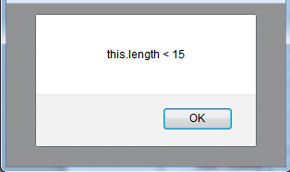
Rendering
Changing the 3 in arr.splitEqual(3) to 2
Changing this 2 to, say 15

Slide 7
In prob1.js, assign to Array.prototype.splitEqual an anonymous function with 1 argument say, num
num specifies the number of slices in the array returned
Note: the array on which splitEqual() is invoked is denoted by this in the code in the anonymous function
First check whether num > this.length
If so, construct an error,
new Error("this.length < " + num)
and throw it

Slide 8
Next, create an empty array arrArrs for the slices
In the end, this array is returned
Suppose len is this.length
The number of elements in the shorter slices is the quotient of len by num
The number of slices at the beginning with an extra element is the remainder of len by num
The length of each of these is the quotient plus 1
JavaScript lacks an operator for the quotient (integer division) of x by y
Implement it as Math.floor(x/y)
Initialize some variables as follows
quotient = Math.floor(this.length / num );
remainder = this.length % num;

Slide 9
Need 2 variables to delimit the part of this for the next slice
low is the index of the 1st element in the next slice
high-1 is the index of the last element
Initialization is
low = 0;
high = quotient;
Loop over this (the array splitEqual() is invoked on) num times
for ( i=0; i<num; i++ ) {
On each iteration, copy a slice to arrArrs

Slide 10
On each iteration
Copy to arrArrs a slice of this, from this[low] through this[high-1]
Update low and high so that
low has the old value of high
The new value of high is this old value plus quotient
At the beginning of an iteration, decide whether the slice added in that iteration should contain an additional element
Use remainder to count down
If remainder > 0,
increment high by 1 (to include the additional element) and
decrement remainder by 1
For this problem, submit your prob1.js file

Slide 11
Problem 2 (3 points)
You are given (on the assignment page) PHP file prob2.php with a gap
<?php
$arr = array(
"Ed" => array( "Exam 1" => 89, "Exam 2" => 76, "Exam 3" => 86 ),
"Ken" => array( "Exam 2" => 86, "Exam 3" => 91, "Exam 4" => 81,
"Exam 5" => 78 ),
"Sue" => array( "Exam 1" => 82, "Exam 3" => 71, "Exam 5" => 79 )
);
// Missing code
echo "The highest score was $max, by $maxName on $maxExam.";
?>
In array $arr, picture the rows as students, the columns as exams
The value in a cell is the score the student (row) received for the exam (column)

Slide 12
But
there are different numbers of exams for different students,
different exams are recorded for different students, and
the order in which the exam-score pairs appear may differ from student to student
The missing code is a nested loop that sets
$max to the largest exam score in the 2D array,
$maxName to the name of the student with that score, and
$maxExam to the name of the exam on which that student made that score

Slide 13
The easiest way to work out this program is to work with PHP on the command line (see the slides)
A trace when this is executed from the command line:
C:\SomeFolder>php prob1.php
The highest score was 91, by Ken on Exam 3.
Turn in this one file with the gap filled in

Slide 14
Problem 3 (6 points)
This is just like Problem 4 in Assignment 7 (manipulating the DOM tree) except that it uses jQuery
A listing of prob3.html (download from the assignment page)
<html>
<head>
<meta charset="utf-8" />
<title>Problem 3</title>
<script type="text/javaScript" src="jquery-2.1.1.js">
</script>
<script type="text/JavaScript" src="prob3.js">
</script>
</head>
<body>
Continued

Slide 15
<h3>
Members
<span style="font-size:14; font-weight:normal">
(Click a member to remove)
</span>
</h3>
<ul id="mems">
<li>Fred</li>
<li>Bill</li>
</ul>
<p>
New member: <input type="text" size="8" id="newm" />
<input type="button" value="Click to add" id="bt" />
</p>
</body>
</html>

Slide 16
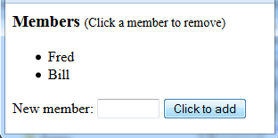
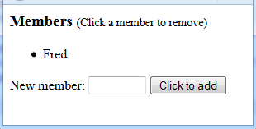
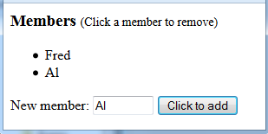
The user clicks on a list item to remove it
Adds new list items using content in a textbox
Initial rendering
The result of clicking on Bill
The result of typing Al in the textbox and clicking the button Click to add
If Al (or Fred) were clicked here, it too would be removed

Slide 17
prob3.js references a local copy of the jQuery distribution file
Download it from the assignment page
Also references prob3.js, which you write
prob3.js consists of a single anonymous function executed when the HTML has been loaded it
$('document').ready(function () {
// You provide the code that goes here.
});
The body of the function consists of 2 jQuery statements
One statement makes an anonymous function the click handler for li elements
This function removes the li element where the click occurs (think this)

Slide 18
The other statement in the top-level anonymous function makes an anonymous function the click handler for the button (with id="bt")
This function
creates an li element with the required click handler and
appends it to the content of the ul element, after the li elements already there
The li element created is of the form
<li>⟨text⟩</li>
where ⟨text⟩ is the value (use method val()) of the textbox (with id="newm")
The click handler for this is the same as that for the li elements already present,
viz., if removes the li element where the click occurs
For this problem, submit your prob3.js file

Slide 19
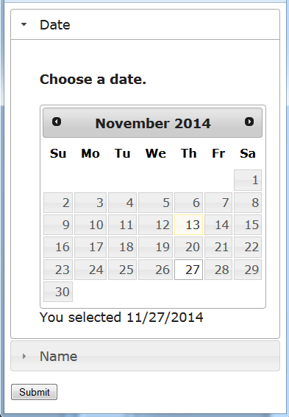
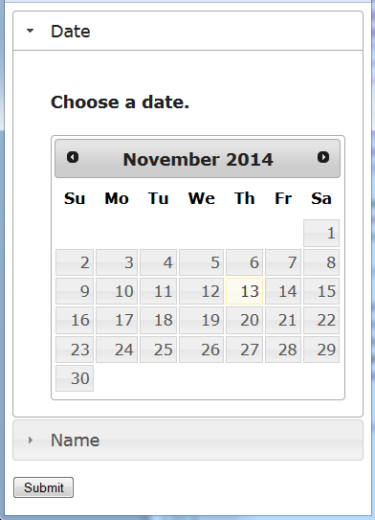
Problem 4 (6 points)
Use jQuery UI for an accordion display that’s the content of a form element
The accordion has 2 panels,
one with a datepicker
the other with a fieldset with 2 textboxes, for the user’s first and last names
Initial rendering
The user clicked the date for Thanksgiving

Slide 20
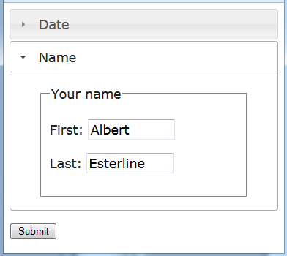

The user clicked the title of the Name panel (expanding that panel and collapsing the Date panel)
Entered values in the textboxes for the first and last names
The response after the user clicked the Submit button with the 2 panels filled out as shown

Slide 21
The HTML document is named prob4.html
The script with the jQuery code is prob4.js
The form element specifies that, on submission, a GET request is sent to prob4.php (in the same folder)
The textboxes in the Name panel have name="first" and name="last", resp.
When the user clicks a date in the datepicker, the jQuery code (in prob4.js)
appends the date to the string "You selected " and
makes the result the content of a div in this panel;
inserts a hidden field after the submit button with name='date' and the selected date (e.g., '11/27/2014') as its value

Slide 22
Listing of prob4.php (download from the assignment page)
<?php
$first = $_GET['first'];
$last = $_GET['last'];
$date = $_GET['date'];
?>
<html>
<head>
<meta charset="utf-8" />
<title>Problem 4</title>
</head>
<body>
<?php
echo " <p>$first $last selected $date.</p>\n";
?>
</body>
</html>

Slide 23
A listing of prob4.html with a gap for the accordion code
Download from the assignment page
For the jQuery core and the jQuery UI JavaScript and CSS files, we use the URLs for the CDN
<html>
<head>
<meta charset="utf-8" />
<title>Problem 4</title>
<link rel="stylesheet" href=
"http://code.jquery.com/ui/1.11.2/themes/smoothness/jquery-ui.css" />
<script type="text/JavaScript"
src="http://code.jquery.com/jquery-1.10.2.js">
</script>
<script type="text/JavaScript"
src="http://code.jquery.com/ui/1.11.2/jquery-ui.js">
</script>
<script type="text/JavaScript" src="prob4.js">
</script>
</head>
Continued

Slide 24
<body>
<form action="prob4.php" method="get">
// Include your code here
<p id="sub"><input type="submit" value="Submit" /></p>
</form>
</body>
</html>
Note: The submit button is inside a p element with id="sub"
The code filling the gap is a div element with id="accordion"
The 1st panel has 2 div elements
One, with id="datep", holds the datepicker
The other, with id="selected", is given the "You selected …" text when the user picks a date

Slide 25
File prob4.js again consists of a single anonymous function executed when the HTML has been loaded
$('document').ready(function () {
// You provide the code that goes here.
});
The body of the function consists of 2 jQuery statements
One makes the div with id="accordion" hold the accordion
The panels must be large enough to hold their content
Invoke accordion() with a heightStyle parameter whose value is "content"
Recall: Parameters to these methods are actually key-value pairs in an object literal
Our call should be
accordion({ heightStyle: "content" })

Slide 26
The 2nd jQuery statement in the body of the anonymous function makes the div element with id="datep" hold the datepicker
We pass datepicker() 1 parameter, onSelect, with an anonymous function as its value
The call has the form
datepicker( { onSelect: ⟨function⟩} )
where ⟨function⟩ is the function called when a selection is made (by clicking) in the datepicker
Recall: When the system calls this function, it passes it
1st argument: the date in string form, "mm/dd/yyy"
2nd argument (doesn’t concern us here): an object corresponding to the datepicker widget

Slide 27
The body of this function should in turn consist of 2 jQuery statements
The 1st sets the text of the div with id="selected" to a string of the form
"You selected ⟨date text⟩"
where ⟨date text⟩ is the string that’s the 1st parameter of this anonymous function
The 2nd creates a hidden field of the form
<input type='hidden' name= 'date' value='⟨date text⟩' />
where ⟨date text⟩ is as above
Inserts it just after (and outside) the p element with id="sub"

Slide 28
Be careful with quotation marks when constructing the input element
My code for the string from which this element is formed:
"<input type='hidden' name= 'date' value='" + dateText + "' />"
dateText is the 1st parameter of the anonymous function (above denoted with ⟨date text⟩)
For this problem, submit files prob4.html and prob4.js

